Slide 1
Grimm’s Fairy Tale
Team xxx
Name1
Name2
…

Slide 2
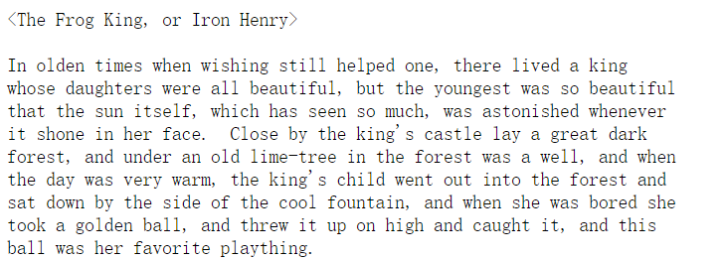
Corpus
209 Grimm’s Fairy Tales Crawled from https://www.cs.cmu.edu/~spok/grimmtmp/
Corpus Size: 1.5MB
Sample:

Slide 3
Approach
Target: fairy tale generation
Preprocessing: lower case
Split: 90% Train, 10% Validation
Evaluation: Cross Entropy, Perplexity
Framework: Pytorch
Modelling:
Char by Char
Word by Word
One Hot Encoding
Batch Size = 256
Variable Sequence Length
LSTM (Hidden = 512, 2 Layers)
Adam Optimizer
Word Embedding
?
?
?
?

Slide 4
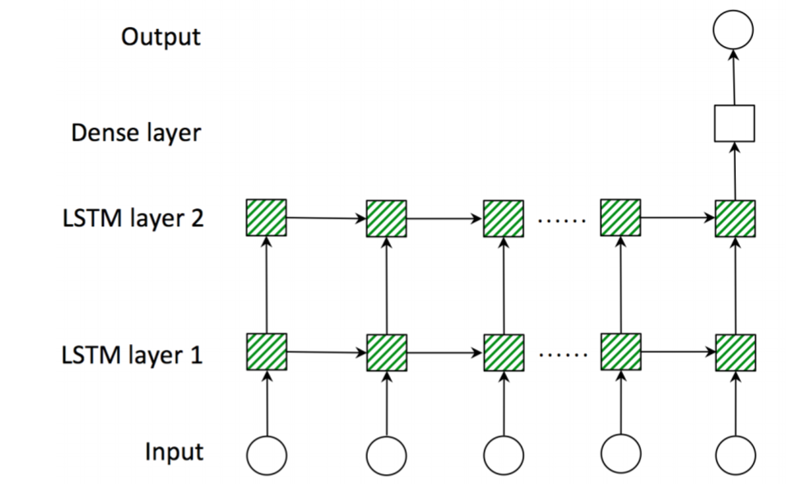

Char by Char LSTM
Y1
Y2
Yseq_len
[256*Seq_Len,44]
[256*Seq_Len,512]
4
[256,Seq_Len,512]
Ht, Ct
1
[256*Seq_Len,44]
X1
X2
Xseq_len

Slide 5
Word by Word LSTM

Slide 6
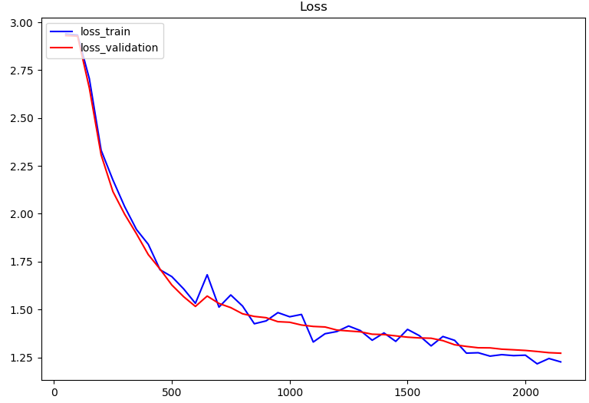
Evaluation
Char by Char
Word by Word

Slide 7
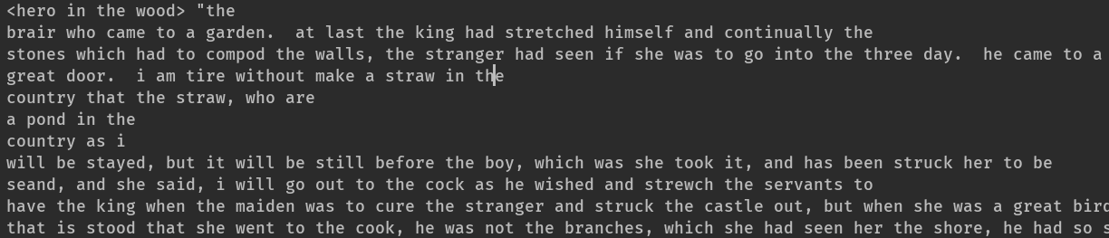
Generation Result
Char by Char
Word by Word

Slide 8
Conclusion
Evaluated two LSTM model for language generation
Found xxx model is better as the training is faster and the result generated make more sense

